Slide 1
Kelompok 1
A project by
2540117786-Joshua Satya Laksana
2540128966-Renardo Tunggara
2502008246-Athaillah Adhar Jumana
* See slide notes for page directions
Notes:
When listing all project collaborators, either use commas or bullets

Slide 2
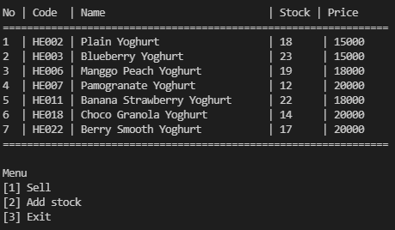
Program
Notes:
Insert a map of your colony (draw it, ink it, or create it in PPT- be creative!)
Insert -> Pictures for photos
Draw for digital inking
Insert -> Shapes if you want to create it in PPT
All mountains, towns/villages, bodies of water/waterways, landmarks, etc. should be clearly labeled

Slide 3
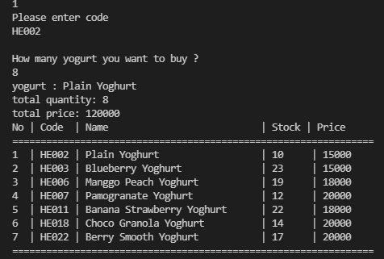
Sell

Slide 4
How It Works ?

Slide 5
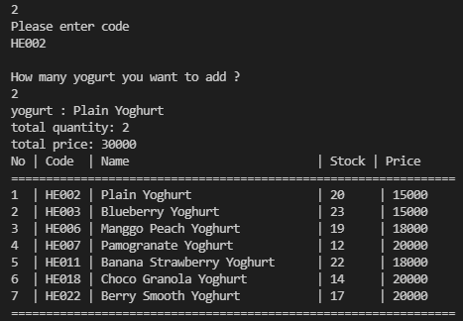
Add Stock

Slide 6
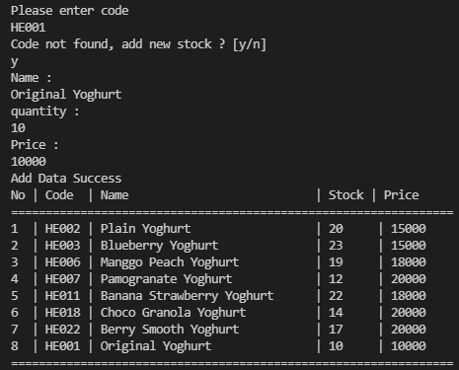
Add Stock

Slide 7
How It Works ?

Slide 8
How The Struct Works
struct yogurt // Struct bernama yogurt
{
char code[6];
char name[100];
int stock;
int price;
int valid; // Verifikasi apakah struct bernilai atau tidak
} barang[100]; // Memiliki 100 data yang dapat ditampung

